Slide 1
LiveS.T.R.E.A.M.
Problem Based, Collaborative Learning
Science
Technology
Robotics
Engineering
Artistry
Mathematics
Deburgos Middle School
401 W. Lehigh Ave.
Phila, PA 19133

Slide 2
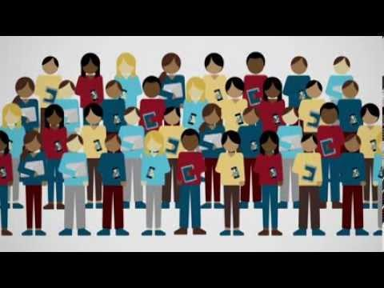
The Leaky Tech Pipeline

Slide 3
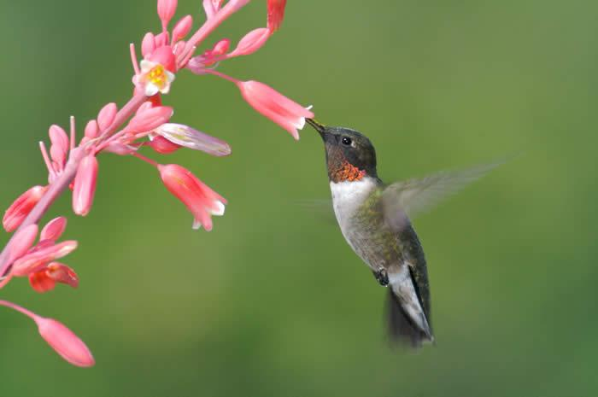
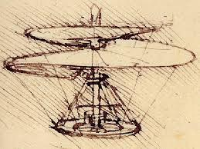
The Vision
Enhance Latino & African American student motivation to persist on trajectory toward college
Develop the problem solving, critical thinking, & creative/decision making abilities required for Leadership
Expose, Engage, & Immerse Latino & African American children in the engineering design process
Produce STEM Professionals who routinely combine artistry/storytelling with logical/analytical thinking in order to make dynamic new concepts/goods

Slide 4
Long Range Objectives
Offer meaningful teaching thru project based, collaborative learning
Model core values & demonstrate impact that active learning has for our students
Adapt STEM activities to the school environment & a student centered approach
Train students for leadership roles & college prep atmosphere
Career exploration: STEM, art/graphics design, sports marketing

Slide 5
STATEMENT OF PURPOSE
To Integrate technology into the school’s curriculum to facilitate the initiation of seed programs that will ultimately culminate into:
a STEM education pipeline featuring project based, blended learning
Building through my 7th grade science class & an after school program
Help future engineers begin designing needed products that are both functional & aesthetically pleasing

Slide 6
Activies Offered
First Lego League (FLL)
year round
9-14 year olds
1.5hrs/ 3x
Engineering/Environmental/Computer App
Robotics/ Program Design/Core Values*
regional/national
teamwork/programming/problem solving/creativity/core values
Video/core values,gratitude/Tshirt,hats

Slide 7
Activies Offered 2
Future City
16 weeks
12-14 year olds
1.5 hrs/3x
Engineering/Art/Computer App
Design/Art/Writing/Problem Solving/etc
regional
teamwork/writing/oral presentation/problem solving/creativity/core values
Concept of a future city in virtual 3D/physical layouts

Slide 8
Activies Offered 3
A.L.I.C.E.
10 weeks
9-14 year olds
1.5 hrs/2x
Computer App
Game Design/Animation
none
programming, animation
mobile apps for sale on google play store

Slide 9
Activies Offered 4
MIT App Inventor
10 weeks
9-14 year olds
1.5 hrs/2x
Computer App
Program Design/Dev
none
programming, building apps
mobile apps for sale on google play store

Slide 10
Activies Offered 5
SeaPerch
10 weeks
9-14 year olds
1.5 hrs/ 2x
Eng/Env/Computer App
Robotics/Program Design
regional

Slide 11
EDUCATIONAL PURPOSES
Our program is being designed to meet the criteria below (as taken from the Bayer Corporation’s Planting the Seeds for a Diverse U.S. STEM Pipeline: A Compendium of Best Practice K-12 STEM Education Programs):
1. Challenging Content/Curriculum
• An inquiry-based, experiential curriculum that is clearly defined & understood
- related to real-world applications
- encourages critical thinking, problem solving & team working
- goes beyond minimum competencies
- reflects local, state &/or national st&ards
2. An Inquiry Learning Environment
• where teachers & their students COLLABORATE as active learners
- students’ diversity, individuality & uniqueness are recognized & respected

Slide 12
Managerial (Administrative) Purposes
2. Sustaining An Inquiry Learning Environment
- teachers have access to & time allotted for professional development that hones their science knowledge & experiential teaching approach
- necessary curriculum materials are supplied in full
3. Defined Outcomes/Assessment
• Goals are clearly identified and success is measured against them
- assessment tools are designed to measure outcomes
- assessment provides:
*both quantitative and qualitative information
*basis for research and continuous improvement of program

Slide 13
COMMUNICATION PURPOSES
4. Sustained Commitment/Community Support
• Program has strong leadership and sufficient resources
- school and/or school district support
- community support, including parents and private industry
5. Continuity of Program Funding
• Focusing on the Following Best Practices
• Improving student outcomes
• Drawing potential funders
• Garnering support from stakeholders

